Slide 1

sdsdss
Copy by Joan Lumanauw | July, 2015
USER RESEARCH

Slide 2

YOU ARE NOT THE USER
"Tanggung jawab Anda adalah melangkah keluar dari perspektif Anda sendiri, untuk benar-benar melatih empati dan sepenuhnya membenamkan diri Anda dalam sudut pandang, dan keadaan psikologis, dari orang yang Anda harapkan untuk merancang sebuah solusi"

Slide 3

Why do we need user research?
Customer insights
Understand what
problems customers
wants solved
Function Priority
Analyze how important
these problems are to
customers
Usability
What products and
features we can develop
to solve these problems

Slide 4

In short,
We do research to ensure that we are solving a
problem that actually exists in people’s lives.
Notes:
Kami melakukan penelitian untuk memastikan bahwa kami menyelesaikan masalah yang benar-benar ada dalam kehidupan orang.

Slide 5
Rule of thumb
If you and your clients don’t know,
You should do some user research.
What do we and our client already know?
What do you need to know to start design?
Is it mission critical user experience?

Slide 6

Now that we know what it means to know your users,
How do we start?

Slide 7

Demographics
Age
Gender
Income
Background
User Research
Needs
Goals
Motivations
Actions

Slide 8
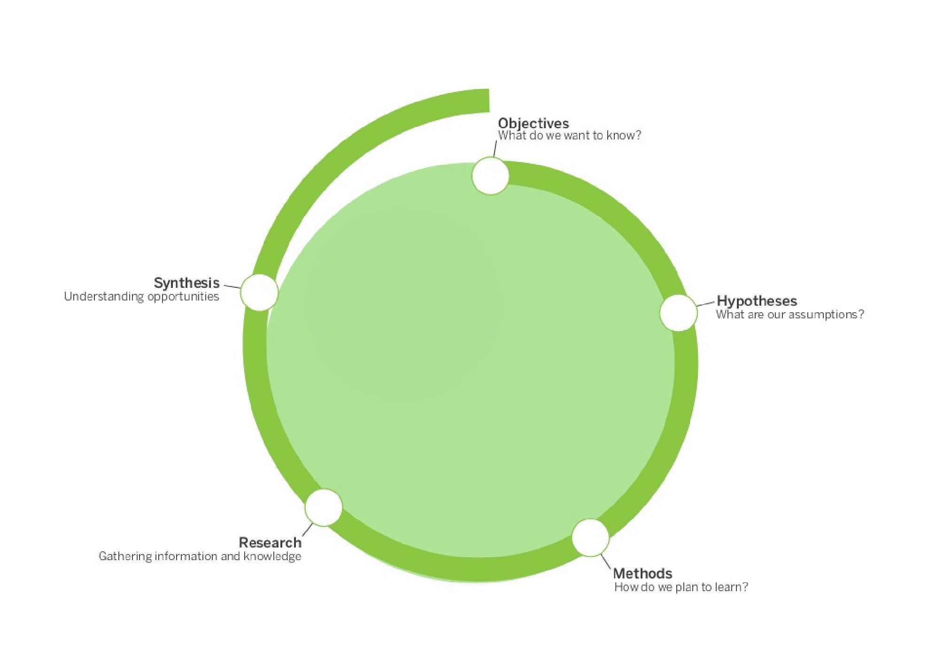
The path of user research

Slide 9
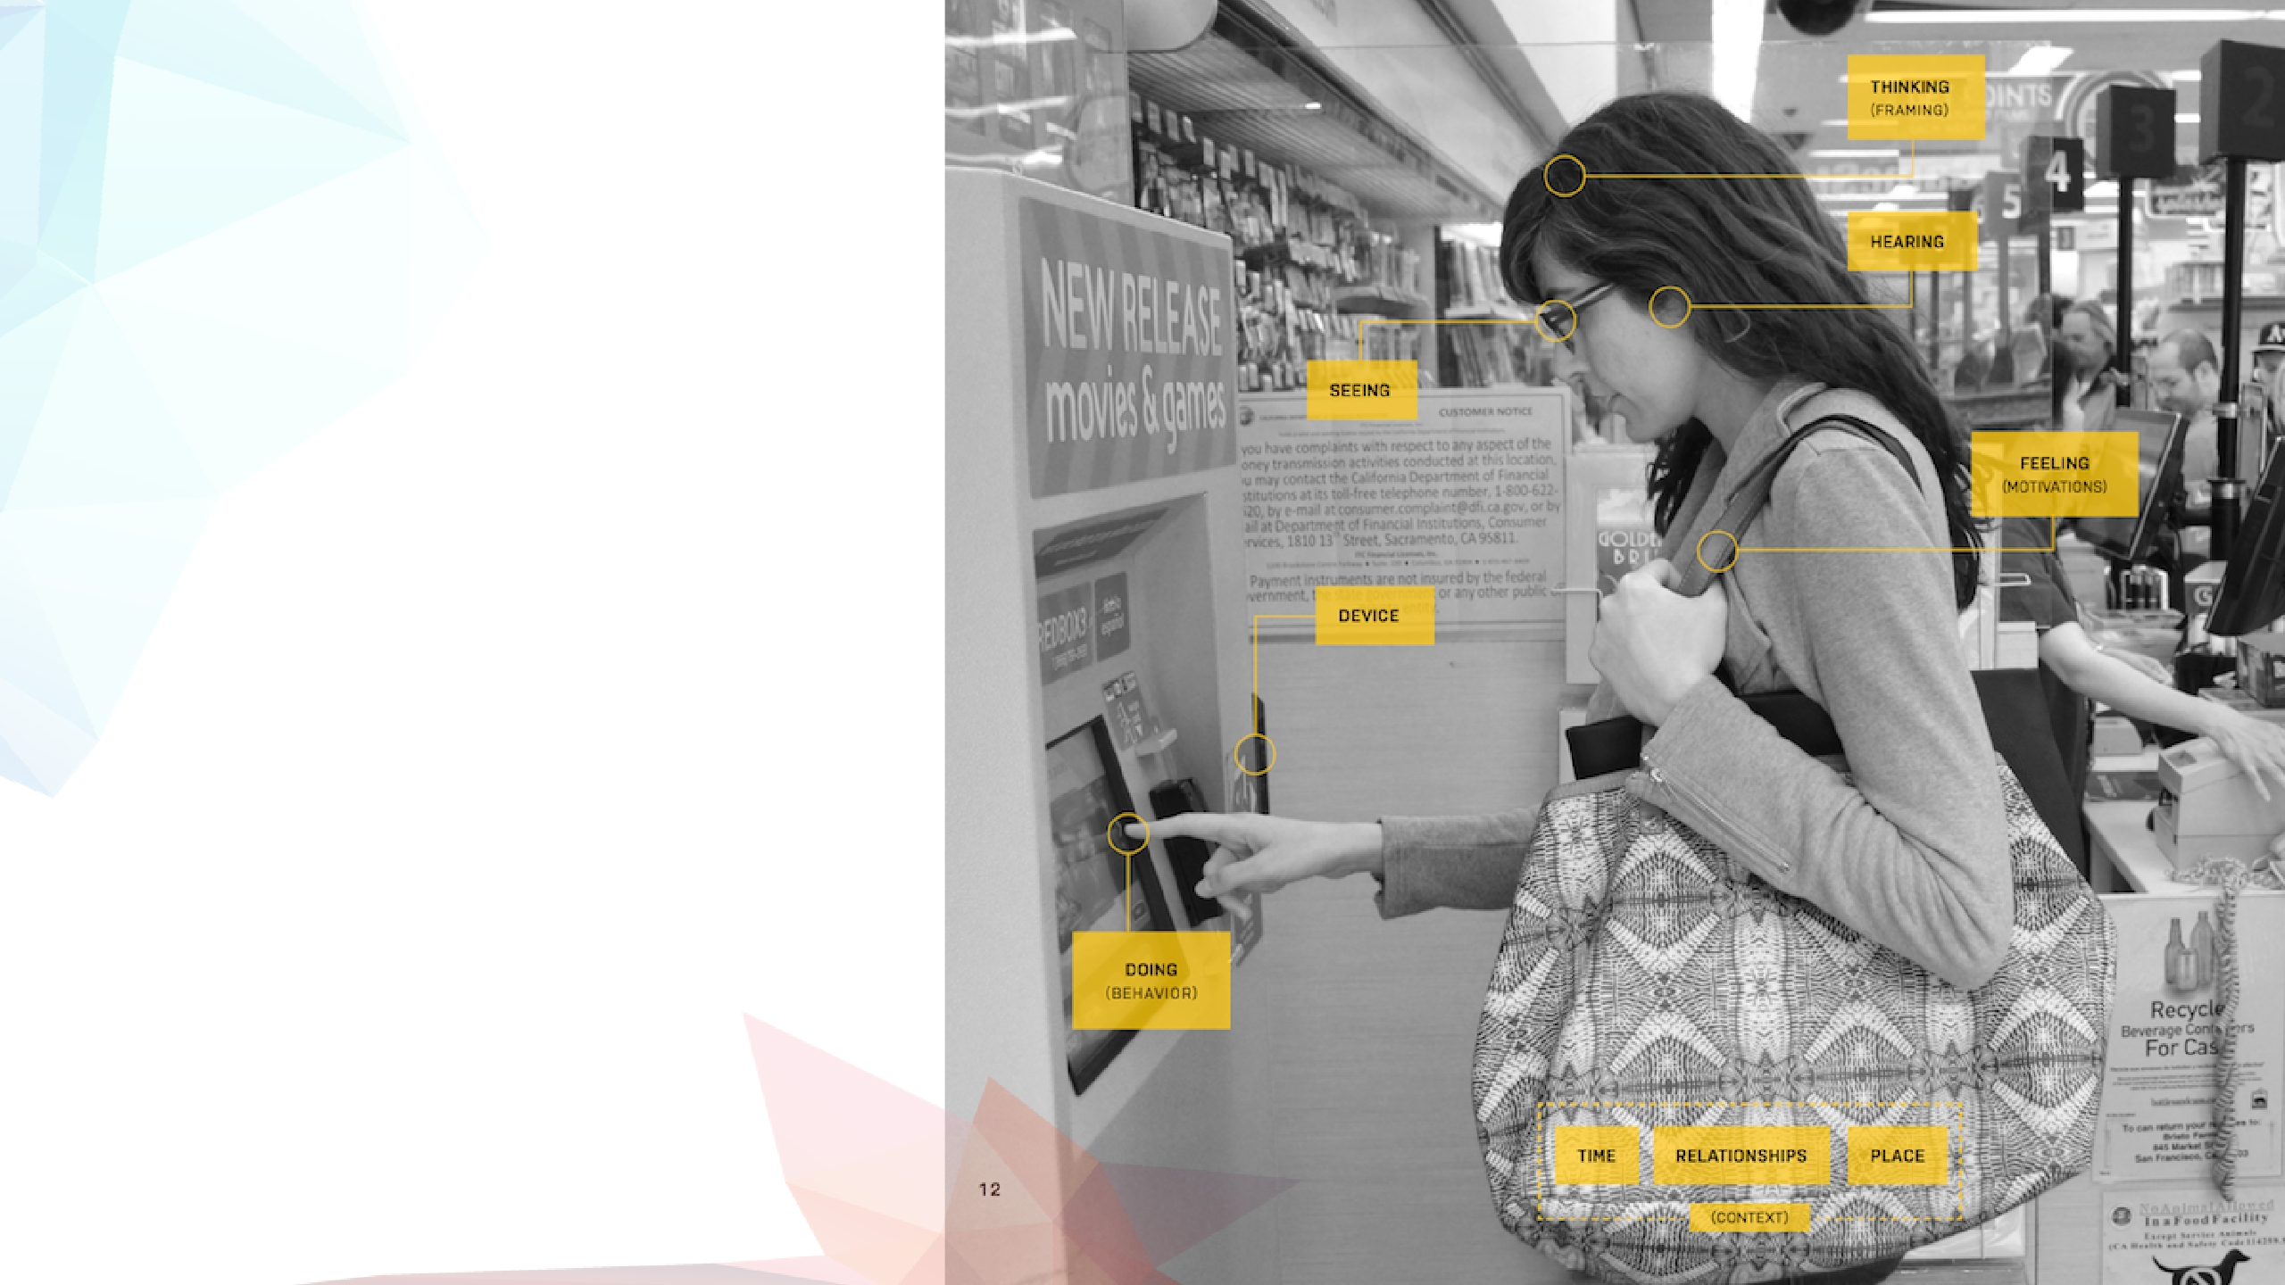
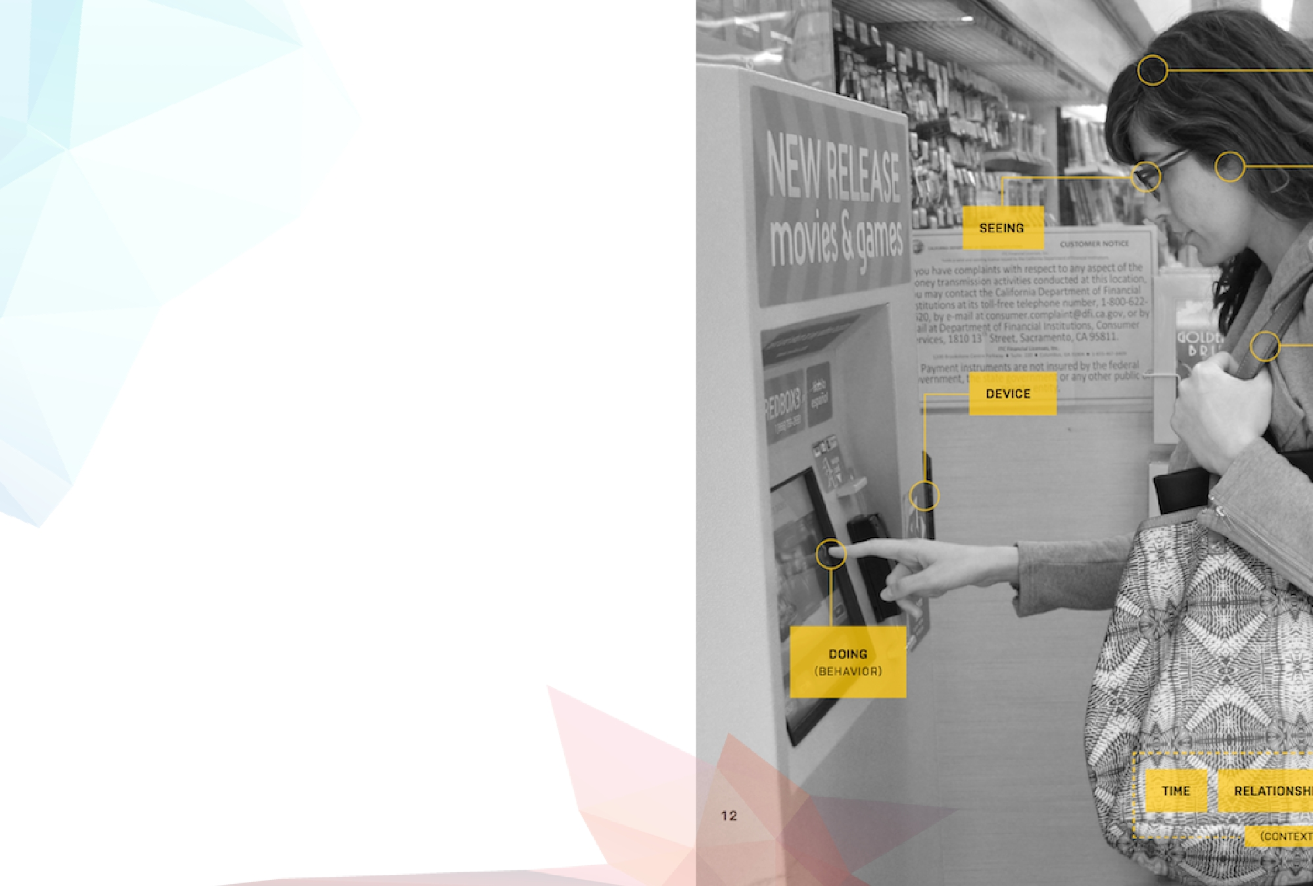
What do we need to
know to understand
our users?
Why
Who
What
Where
When
How

Slide 10

Why are the users coming to us?
Goals? Needs? Triggers?
Who is our user?
Business or consumers?
Demographics?
Background Knowledge?
When are they visiting?
Time of day?
In an emergency?
Daily/monthly?
Relaxed at home or working hours?
What are their habits?
Are they social?
(this is dependant on your product)
How are they visiting?
Mobile or Desktop?
Tablet?
Over the phone?
In person?
General Assembly: User Persona Module

Slide 11


Now that we know what to research,
How do we get all that information?

Slide 12


A few methods we can use..
Surveys
Interview
Focus Group
+
+
-
-
Kumpulkan sejumlah besar
tanggapan dengan cepat
Dapatkan kuantitatif
umpan balik dengan cepat
Sulit untuk masuk
tanggapan mendalam
Belajar tentang
masalah tapi tidak
mengapa itu terjadi
+
+
+
-
+
+
-
-
Dapatkan kualitatif
umpan balik dengan cepat
Wawasan tentang perilaku
dalam konteks sosial
Peserta alfa
mungkin bergoyang umum
pendapat
Memakan waktu untuk
mengatur, menjalankan dan
menganalisa
Diskusi satu lawan satu
Bisa berkumpul secara mendalam
informasi yang ditargetkan
Fleksibel, bisa menjelajah
bersinggungan atau tidak terduga
daerah
Memakan waktu untuk
mengatur, menjalankan dan
Menganalisa
General Assembly: User Persona Module
Notes:
Gather large number
of responses quickly
Get quantitative
feedback quickly
Hard to get in-
depth responses
Learn about
problems but not
why they occur
One on one discussions
Can gather in-depth
targeted information
Flexible, can explore
tangent or unexpected
area
Time-consuming to
organise, run and
Analyze
Get qualitative
feedback quickly
Insights on behaviour
in a social context
Alpha participants
might sway general
opinions
Time-consuming to
organise, run and
analyze

Slide 13

User Interviews
Planning Stage
What do we know?
What do we want to ﬁnd out?
Who are we talking to?
Where will this take place?
How long do we have?
What will the outcomes be?
•
•
•
•
•
•

Slide 14


User Interviews
Recruiting Participants
Are these potential users…. Or your Facebook friends?

Slide 15
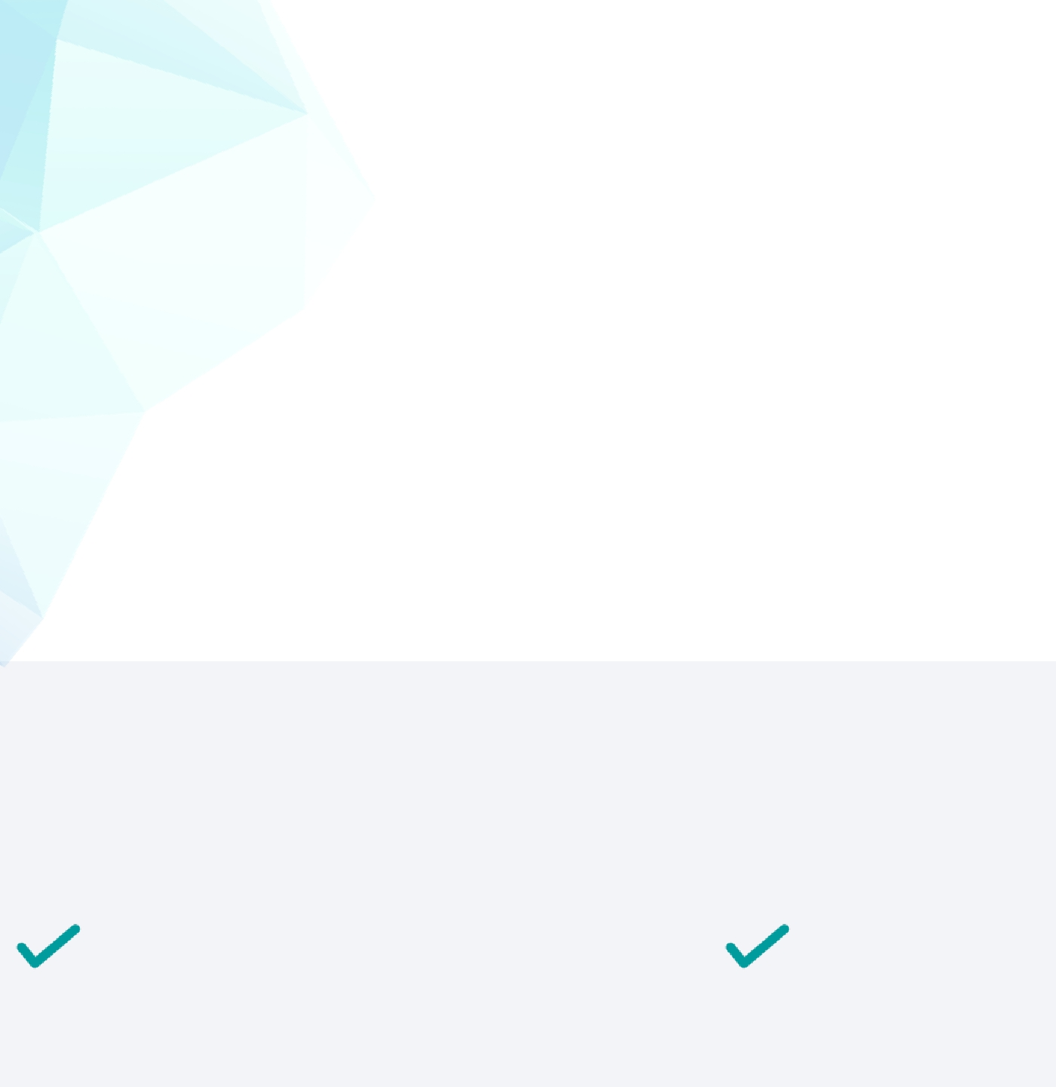

User Interviews
Asking The Right Questions
Never ask intentions, only behaviour
Ask about specific instances, not generalisations
Keep them talking
Never ask leading questions
1.
2.
3.
4.
x
How many times a month
do you go to the gym?
x
Do you usually go to the
gym in the morning?
x
Do you mean
to say…
How many times this month
did you go to the gym?
Tell me about the last
time you went to the gym
General Assembly: User Persona Module
Tell me more..
What do you mean
Notes:
Jangan pernah bertanya niat, hanya perilaku
Tanyakan tentang contoh spesifik, bukan generalisasi
Buat mereka terus bicara
Jangan pernah ajukan pertanyaan utama

Slide 16

User Interviews
Recording & Capturing
Record interviews if possible
• Always ask permission
• Explain why and that it’s for private use
• Take notes but remain focussed on participant
Straight after interview
• Write down the 3 most important insights
• When reviewing recording/notes, write out
each interesting point on individual post it
General Assembly: User Persona Module

Slide 17
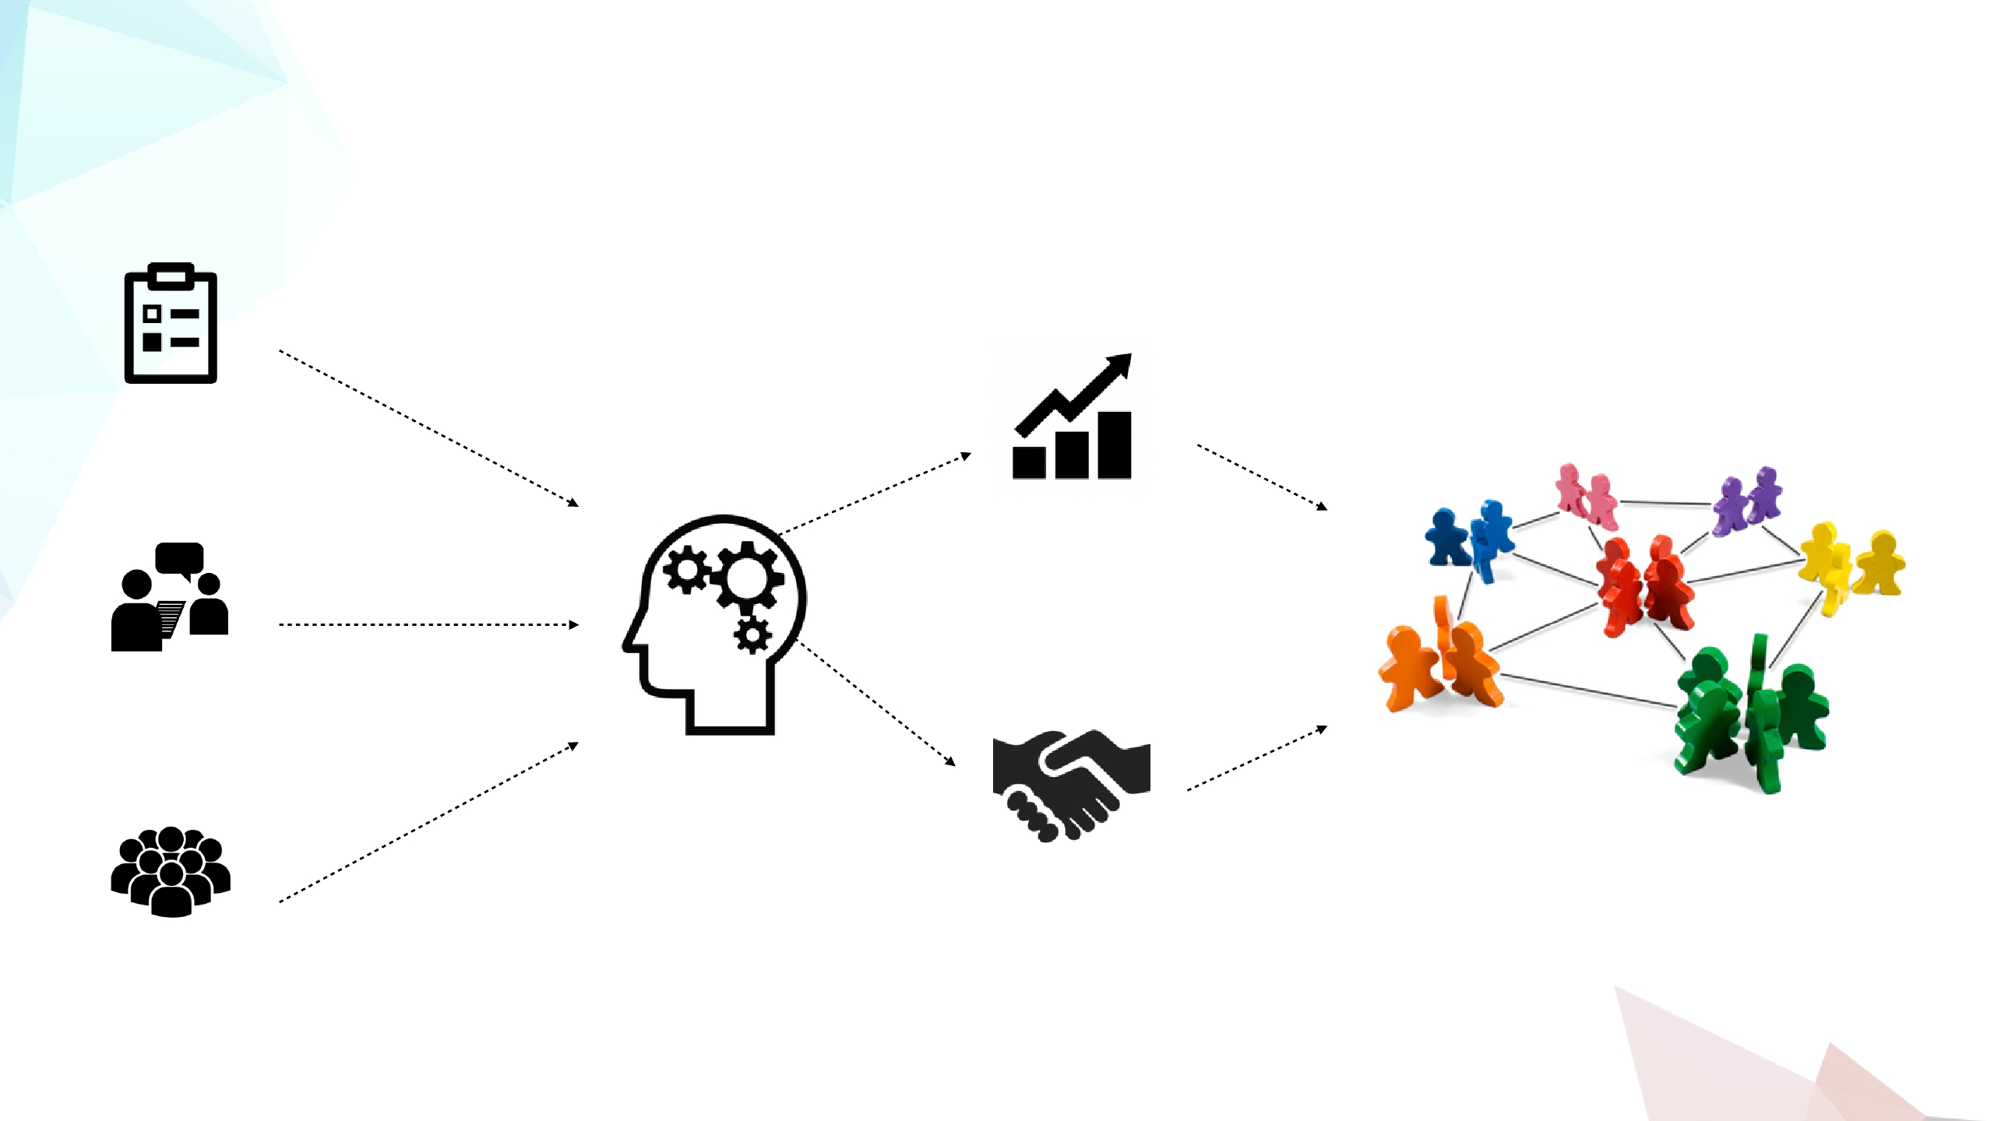
User Interviews
Analyzing User Research
Surveys
Identify Trends
Interviews
Focus Group
Create a logical grouping
of the information and
trends that emerge
Form consensus

Slide 18



Exercise 2.1
User Interviews
Time: 20 Minutes
Case: you’ve been commissioned to redesign the
Mirum Intranet services.
• Prepare a list of questions/topics that you want to
research.
• In pairs, take turns interviewing each other. Be
prepared to share your results.

Slide 19
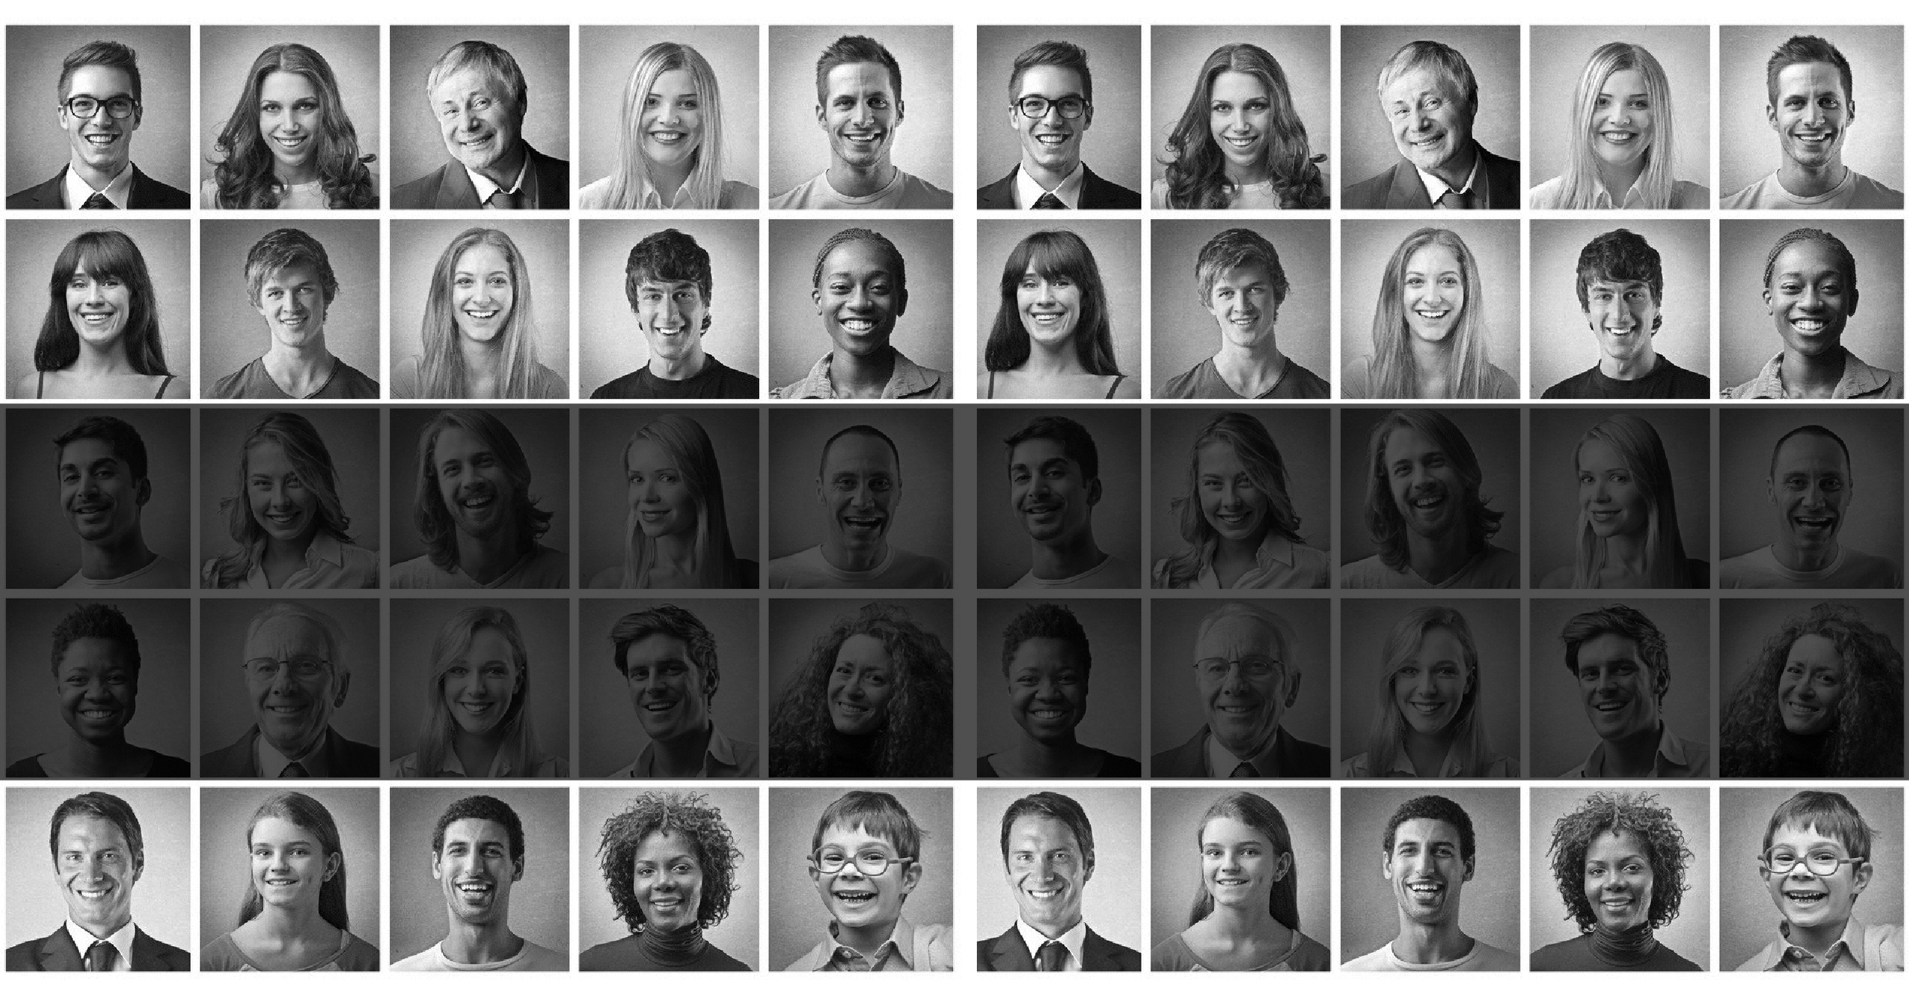
The output of our research should be
User Personas

Slide 20


What is
User Personas
Persona adalah contoh orang dalam diri Anda
target audiens. Personas harus mewakili mayor
grup pengguna untuk situs web Anda
Tujuan personas adalah untuk menciptakan andal dan
representasi realistis dari segmen audiens utama kami untuk referensi. Representasi ini harus didasarkan pada pengguna kualitatif dan kuantitatif penelitian.
Notes:
Personas are an example of a person within your
target audience. Personas should represent a major
user group for your website
The purpose of personas is to create reliable and
realistic representations of our key audience segments for reference. These representations should
be based on qualitative and some quantitative user
research. Effective personas:

Slide 21
E ﬀ ective Personas should be
Jelaskan orang-orang nyata dengan latar belakang, tujuan, dan nilai-nilai
Ekspresikan kebutuhan dan harapan utama grup pengguna Anda
Representasi yang realistis dari segmen audiens utama kami.
Membantu mengungkap fitur dan fungsi universal
Most importantly,
Personas should be based research.
Either qualitative or quantitative

Slide 22
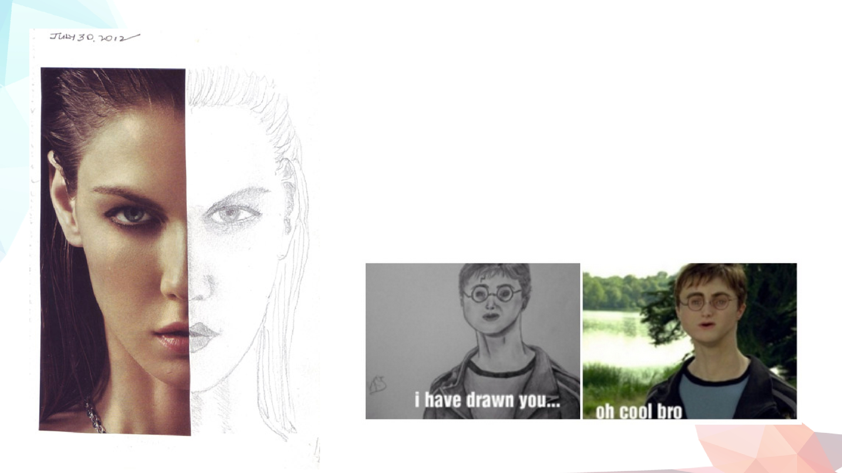
Personas are not
Hanya berdasarkan data pemasaran atau pendapat para pemangku kepentingan perusahaan, apakah mereka pernah bertemu dengan pengguna nyata atau tidak, persona opsional meracuni kumpulan dan akan memberikan pemahaman yang tidak akurat tentang pengguna dan memberikan rasa aman yang salah dan memperkuat asumsi.

Slide 23

Sample Personas
Carol & Family
Young Family
Johan & Emi
Middle-aged Couple
Ellyse
Family Caretaker
Chandra
Young Urban Individual

Slide 24
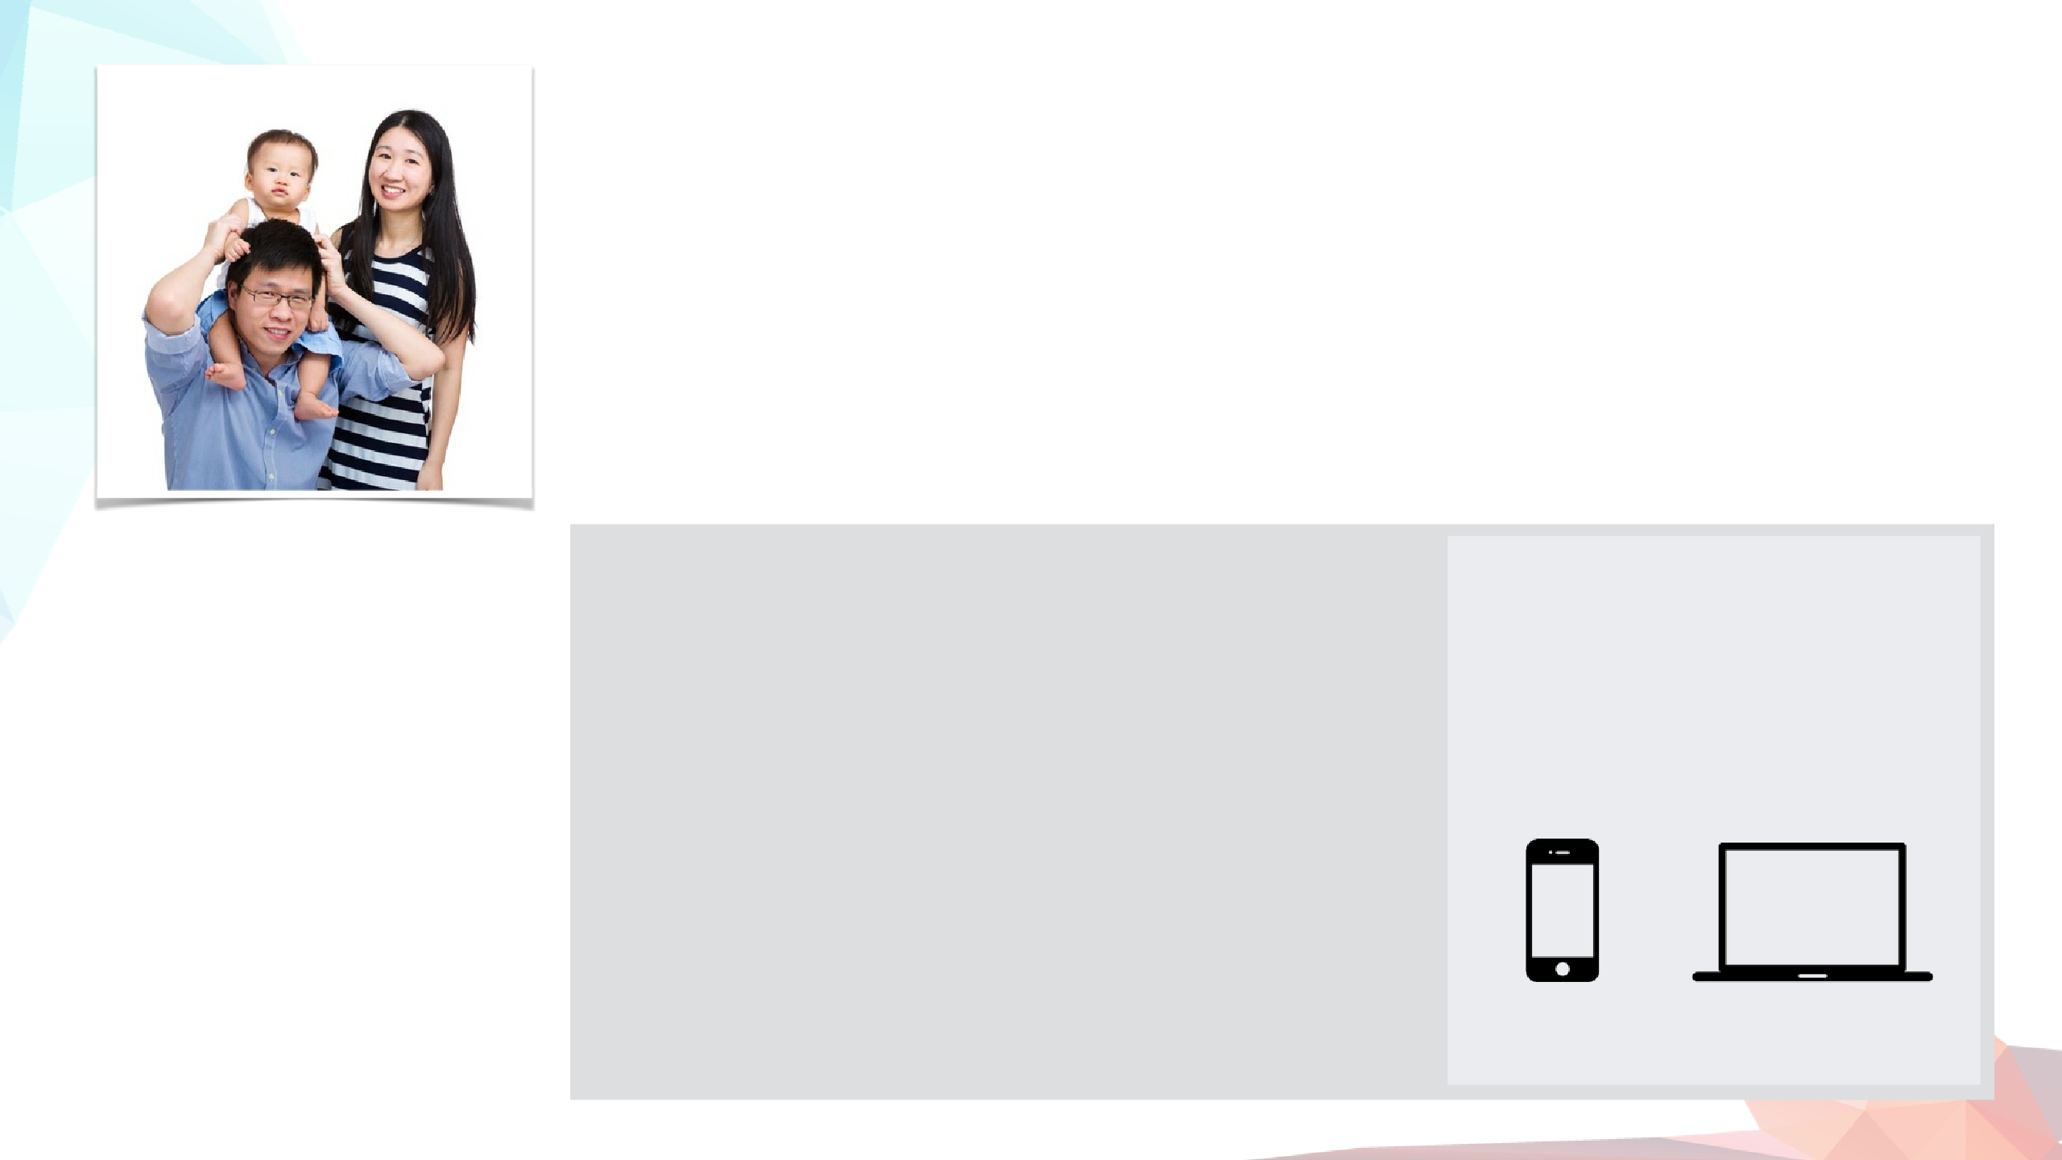
Meet Carol & Family
New Family
Age: 30
Occupation: Stay-at Home Mom
Location: Jakarta
Status: Married
Carol is a dedicated mother of 2 kids. She spends her days taking care of her children and
her husband. She’s constantly worrying about the well-being of her children and their future.
One of her biggest concern is the health of her family. She takes the full responsibility in
making sure her family is healthy and happy.
Goals
What she wants to know
How she access websites
•
•
Carol wants to be ready
when her child is sick.
She wants value for money
and reputable doctors for
•
•
•
If the hospital have a good reputation.
If the doctors are experienced and comes
recommended.
Value for money.
Home
On the Go
her family healthcare.
Fears
• That she chooses the
•
•
•
The available treatment and facilities.
The kind of regular medical care her kids needs
Healthcare plans
wrong hospital/doctors
Where she looks for info
when her child is sick.
That her family cannot
afford the bills associated
with medical care
•
•
•
Other mothers
Hospital website
Friends & family members
•
Primary
Secondary

Slide 25

Meet Johan & Emi
Middle-Aged Couple
Age: 57/54
Occupation: Business Owner
Location: Surabaya
Status: Married
Johan and Emi is an established middle class couple living in Surabaya. Daniel has
recently been diagnosed with cancer and needs immediate care. However, Emi trust
international hospitals better, especially Singapore. She’s the one who takes care of his
treatment needs and does research.
Goals
What they need to know
How they access websites
•
•
Emi wants to give Johan
his best chance at beating
cancer.
She wants to know he’s
getting the best doctors
available to them.
•
•
That Siloam can give them the same/better
standard of treatment that international hospitals
do.
That Siloam is up to par with international
hospitals in terms of facilities, technology and
care quality.
Home
On the Go
Fears
•
That Siloam is the best options for Johan’s health.
•
•
That Indonesia has less
qualiﬁed doctors than
Singapore does.
That the national medical
standard is not up to par.
Where they look for info
• Google search
• Reputable Singapore hospitals
• Friends & Family
Primary
Secondary

Slide 26
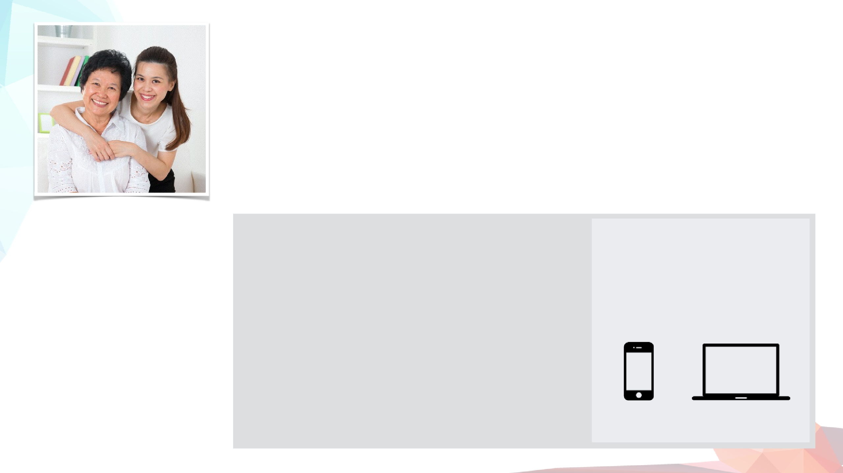
Meet Ellyse
Family Caretaker
Age: 35
Occupation: Business Executive
Location: Jakarta
Status: Married
Ellyse is a successful business exec. She loves her mother very much and feels that she
owes everything to her. Ellyse’s mother is getting old and her health is deteriorating. Her
mother is very passive and always blames her health to her old age. Ellyse is extremely
concern so play’s the role of her mother’s main caretaker.
Goals
What she wants to know
How she access websites
•
•
Ellyse wants to do
everything she can to
ensure her mother’s health
Ellyse wants be alert about
any symptoms her mother
is experiencing.
•
•
•
•
Symptoms and main health concerns for older people
Quality doctors to maintain her mother’s health.
The hospital reputations when it comes to comfort
and quality
The hospitals services and convenience that will give
her the best medical care available when her mother
At work
On the go
Home
Fears
needs it.
•
•
That she is not getting the
best medical treatment
available.
That her visit will be less
than comfortable.
Where she looks for info
• Google search
• Reputable hospitals websites
• Friends & Family
Primary
Secondary

Slide 27
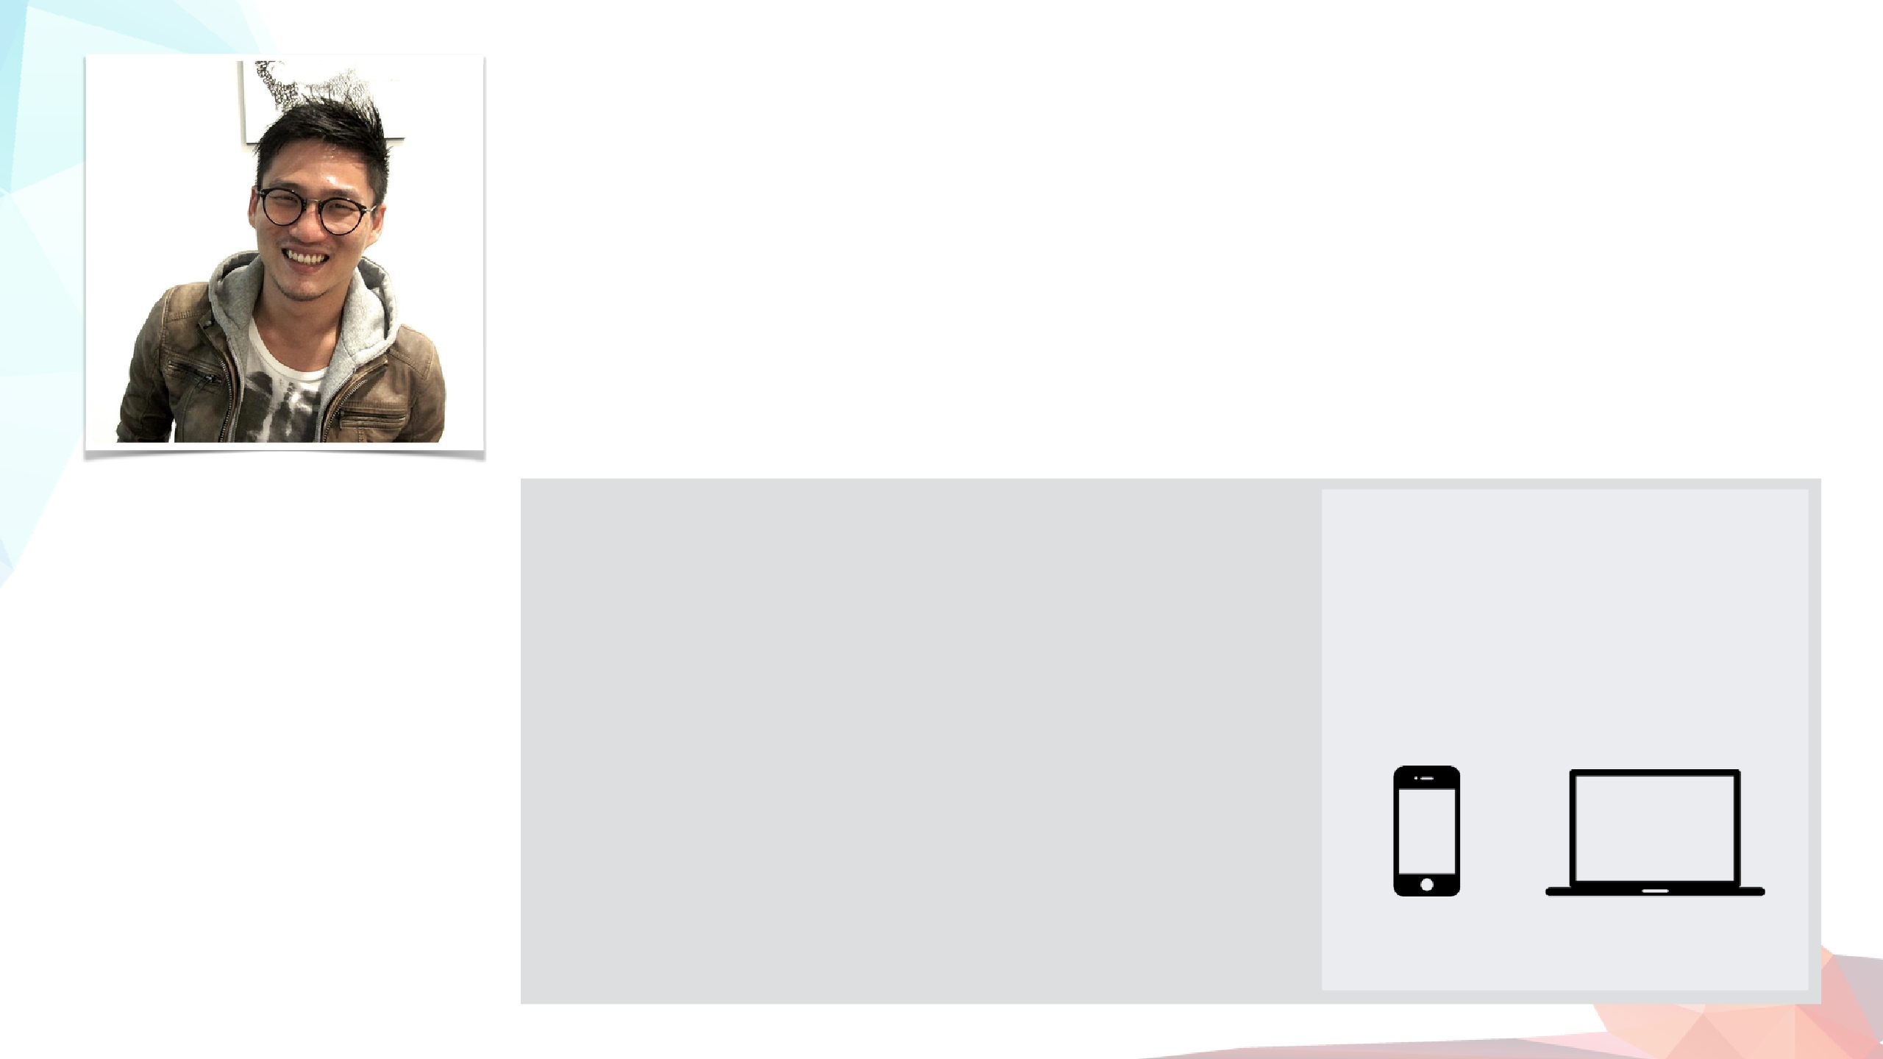
Meet Chandra
Young Urban Individual
Age: 27
Occupation: Advertising Creative
Location: Jakarta
Status: Single
Chandra is 27 years old. He has just entered a phase in his life where he is living
completely independently from his parents. He never had to think about his personal
medical care before, let alone choosing hospitals. He is often confused about all the
things he needs to know about medical care.
Goals
What he wants to know
How he access websites
•
Chandra wants to be
independent. He wants to
know that he can take care
of himself when he gets
sick.
•
•
•
•
What kind of doctors he needs to see for his
symptoms.
The estimated cost of his visit.
When is the best time to go (availability)
The kind of regular medical care people needs
At work
On the go
Home
(check-ups and routines)
Healthcare plans
Fears
•
•
•
Can’t ﬁnance his medical
care and has to burden his
parents
Doesn’t know what to
expect from a hospital visit.
Where he looks for info
• Google search
• Hospital website
• Friends & Parents
Primary
Secondary

Slide 28

Putting your personas in context
User Scenarios
Sample Scenario
I know nothing about Siloam (Exploration)
Skenario membantu menempatkan kepribadian Anda dalam situasi kehidupan nyata di mana mereka menemukan produk Anda, dengan kebutuhan & tujuan tertentu, dalam pola pikir tertentu.
Thinking:
I am unsure but I think
my husband might have
a heart condition.
Feeling:
I hope it’s nothing
serious but I want to
be sure.
Doing:
Researching symptoms
and possible conditions
and treatment.
Notes:
Scenarios help put your personas in a real life situation where they come across your product, with a specific needs & goals, in a specific mindset.

Slide 29

Why can’t we just list down functions and features we need?
Why do we need Personas?

Slide 30
"Untuk siapa kita merancang?"
Persona bukan fiksi menebak-nebak apa yang dipikirkan pengguna target.
Setiap aspek dari deskripsi seseorang harus diikat kembali ke data nyata (diamati dan diteliti)
Persona berfokus pada kondisi saat ini (bagaimana pengguna berinteraksi dengan suatu produk)
Persona bersifat spesifik konteks (berfokus pada perilaku dan tujuan yang terkait dengan domain spesifik suatu produk).

Slide 31


Why We Use Personas
To gain perspective
We do not see things as they are.
We see things as WE are.

Slide 32



Why We Use Personas
As a medium to relate to your users
When a designer creates a
persona, they are crafting the lens
through which they will see the
world. From this vantage point,
when a designer makes a decision,
they do so having internalized the
persona’s goals, needs and wants.

Slide 33
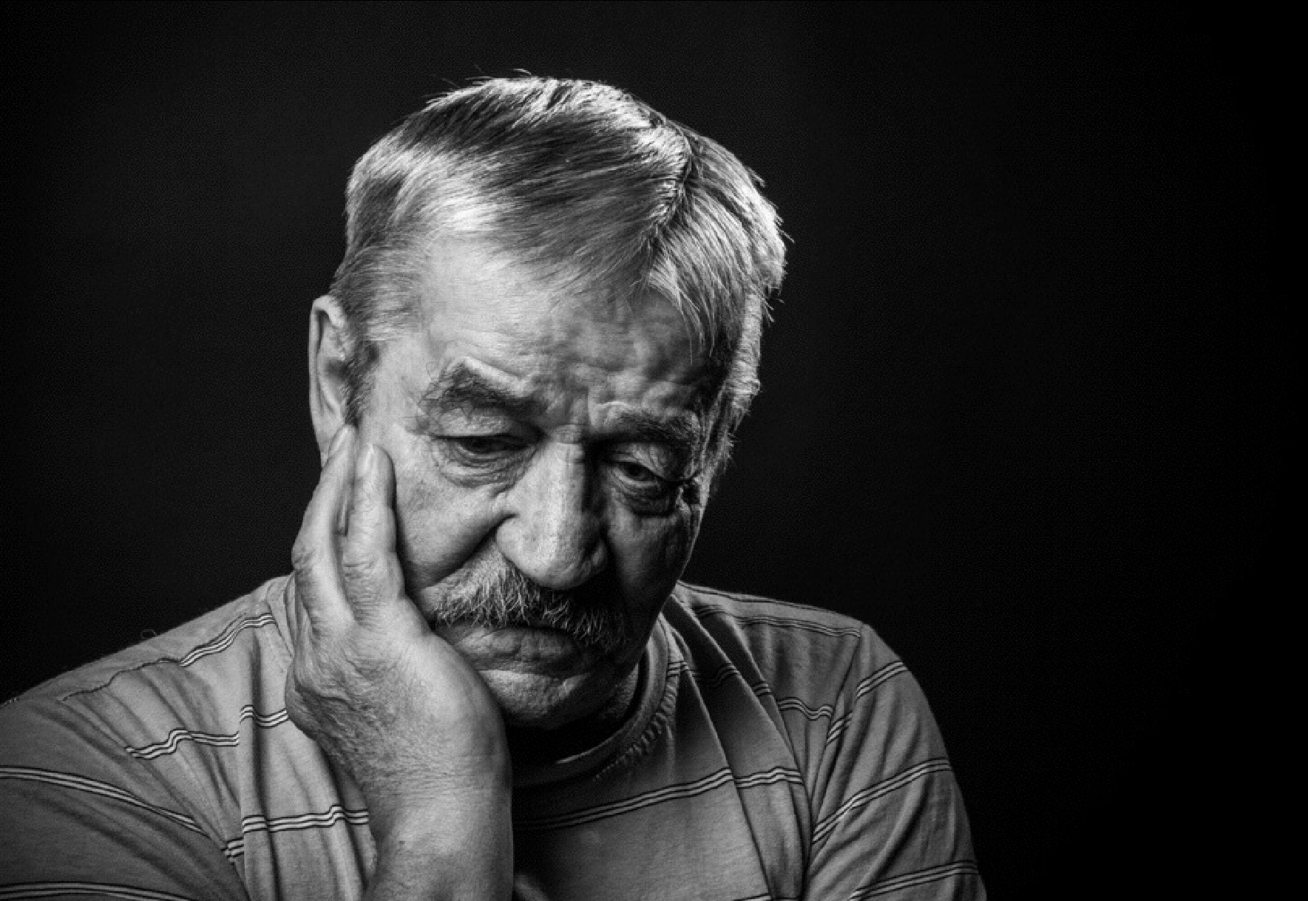
Why We Use Personas
It creates empathy
Empathy [ ˈɛ mp əθ ɪ ] :
The power of understanding and
imaginatively entering into another
person’s feelings

Slide 34
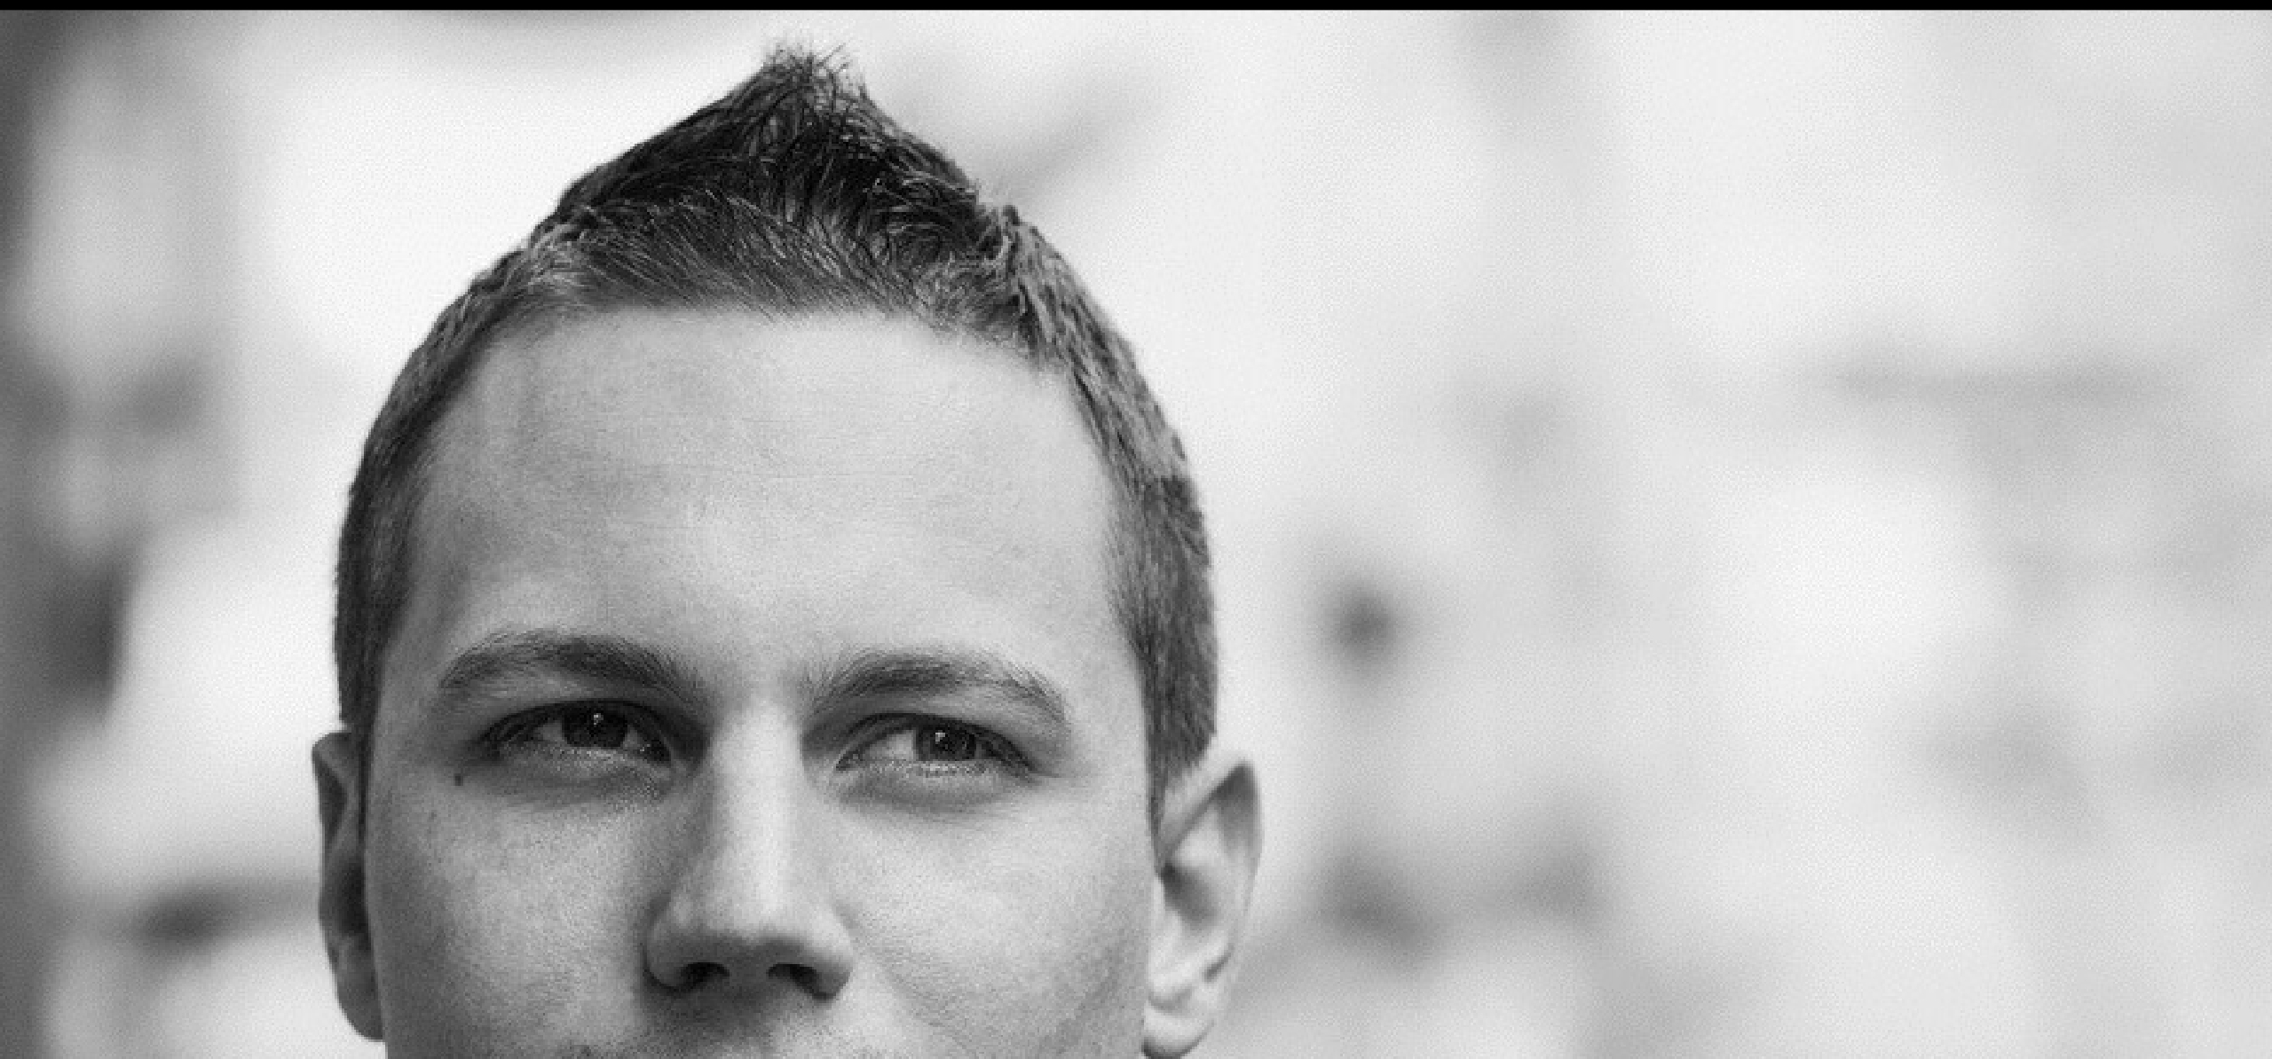
Why We Use Personas
It brings the focus back to the user
Personas help us to deﬁne who the
software is being created for and
who not to focus on. Having a
clear target is important. For
projects with more than one user
type, a list of personas will help
you to prioritize which users are
more important than others.

Slide 35

Which ultimately
Enables us to make better
design & strategic decisions

Slide 36

Speaking of design process,
User Personas in UCD Process

Slide 37

When To Use Personas
User-Centered Design Process
Stakeholder
Interview
User
Research
Creative
Ideation
Experience Requirement
Mapping Gathering
UX Design
Usability
Testing
Production
Launch
Discover
Define
Design
Validate
Develop
User
Journey
User
Flow
Sitemap &
Prototype
Validated
Prototype
Graphic
Design
User
Personas
Idea
Business
Requirement
Code

Slide 38

When To Use Personas
Research & Discovery Phase
Discover
Define
Design
Validate
Develop
User
Personas
User
Journey
User
Flow
Idea
Sitemap &
Prototype
Validated
Prototype
Graphic
Design
Business
Requirement
Code
CREATE PERSONAS DURING THE RESEARCH PHASE TO HELP IDENTIFY AND EMPATHISE WITH USERS
General Assembly: User Persona Module

Slide 39
When To Use Personas
Ideation & Deﬁnition
Discover
Define
Design
Validate
Develop
User
Personas
User
Journey
User
Flow
Idea
Sitemap &
Prototype
Validated
Prototype
Graphic
Design
Business
Requirement
Code
DURING IDEATION AND DEFINITION USE PERSONAS TO QUALIFY IDEAS
General Assembly: User Persona Module

Slide 40
When To Use Personas
Testing & Validation
Discover
Define
Design
Validate
Develop
User
Personas
User
Journey
User
Flow
Idea
Sitemap &
Prototype
Validated
Prototype
Graphic
Design
Business
Requirement
Code
IN TEST AND PROTOTYPE THEY FORM A BASIS FOR RECRUITMENT
General Assembly: User Persona Module

Slide 41
“Research is to see what everybody else has seen,
and to think what nobody else has thought”
Albert Szent-Gyorgyi

Slide 42

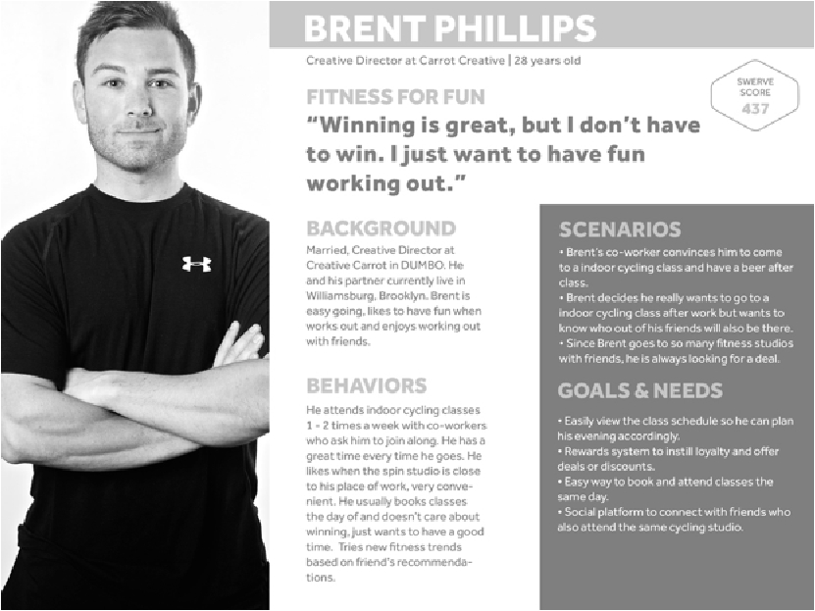
Exercise 2.2
User Personas
Time: 20 Minutes
Dari informasi yang dikumpulkan melalui Wawancara, buat persona yang mencakup latar belakang, kebutuhan, poin yang dirasakan dan tujuan orang yang diwawancarai.
Notes:
From the information gathered in the interview
exercises, create a persona that includes background,
needs, pain points and goals of the interviewee.

Slide 43
Thanks!
Any questions ?

